Slide 1

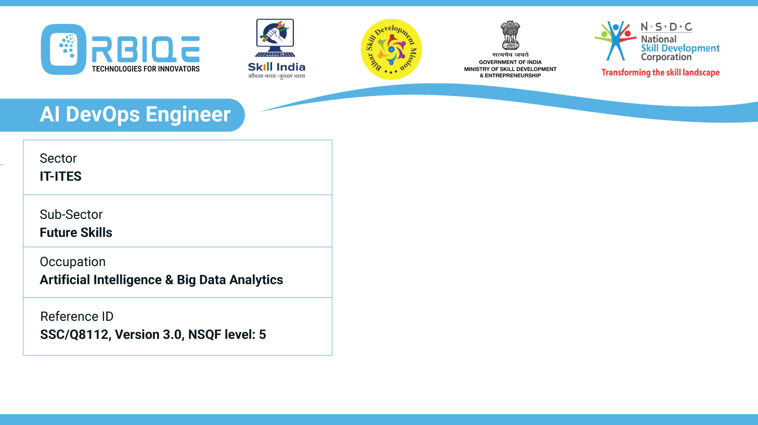
Name- Krishna Kant Dubey

Slide 2

Various CI/ CD Tools to Optimize Communication and Workflow

Slide 3
Agenda
Automation server
CI/CD pipelines within the GitLab version control system
Cloud based CI/CD services with customizable workflows

Slide 4
Automation server

Slide 5
GitLab version control

Slide 6
Cloud based CI/CD services

Slide 7
Thank You

